Slide 1
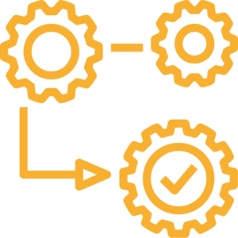
Sandaig Engineering and Apache North Sea in numbers
Full gap analysis on QA/QC and Supply Chain processes performed
3554 supplier QC inspection visits performed
546 QHSE tender submissions reviewed
17 Key Supply Chain/ Quality Processes defined, written an rolled out
603 supplier NCR’s managed
5067 Receipt Inspection Shipments
67 Supplier/ govwrnance audits completed
Inspection and certification requirements added to 21000 Material masters
157 Supplier QPR’s attended

